Slide 1
Part II – Capture of 3D point clouds
Céline Loscos
Celine.loscos@univ-reims.fr
CReSTIC Laboratory
RVM Team
University of Reims Champagne-Ardenne, France

Slide 2
A short history
3D
lays on a set of techniques coming from computer aided-design
which permits to present objects in perspective
3D representation theory started during the renaissance
3D is yet mostly represented on flat support
Notes:
Le paradoxe : la 3D est encore aujourd’hui ultra majoritairement affichée à plat.

Slide 3
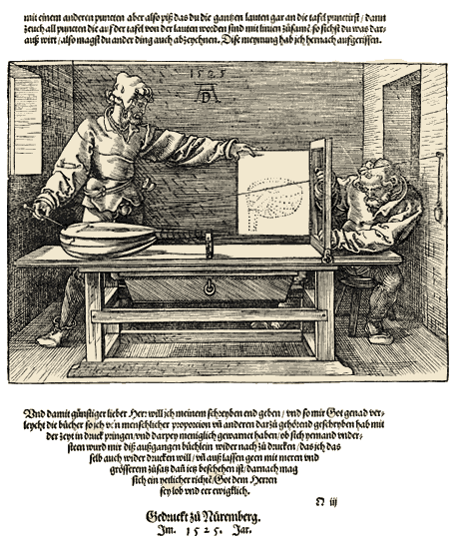
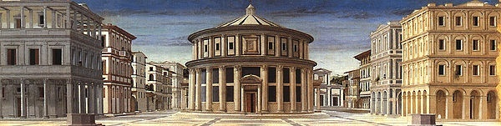
A short history
Perspective
The ideal city,1475, Piero della Francesca
Perspectograph, by Dürer
Notes:
Le paradoxe : la 3D est encore aujourd’hui ultra majoritairement affichée à plat.

Slide 4
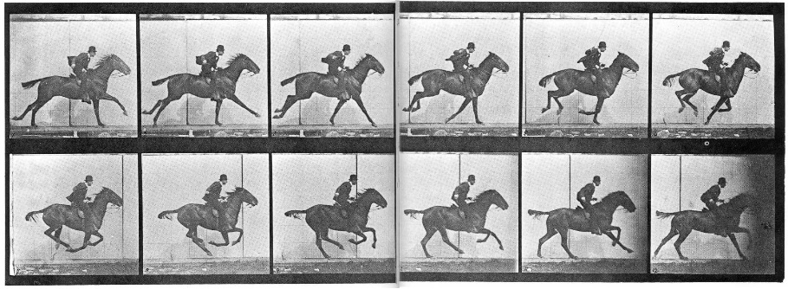
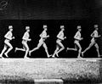
A short history
First videos
Muybridge (1874): multi-cameras
Marey (1882): chronophotography

Slide 5
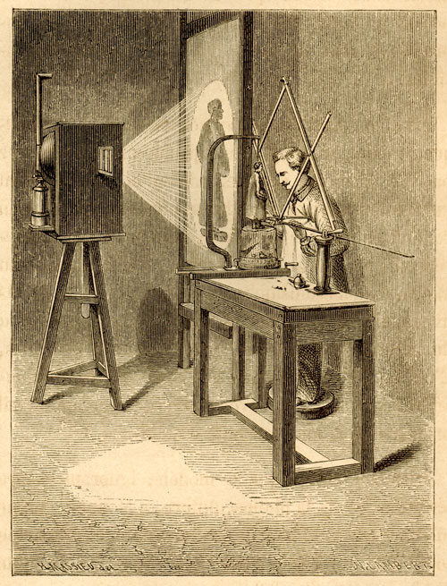
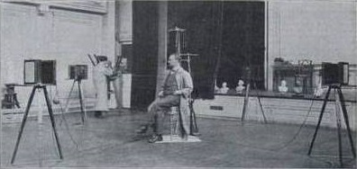
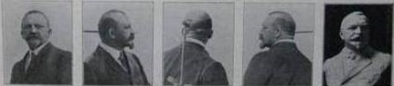
A short history
First 3D reconstruction systems from images
Pantographe
François Willème (1830-1905): Photosculpture

Slide 6
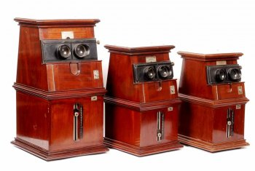
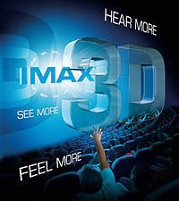
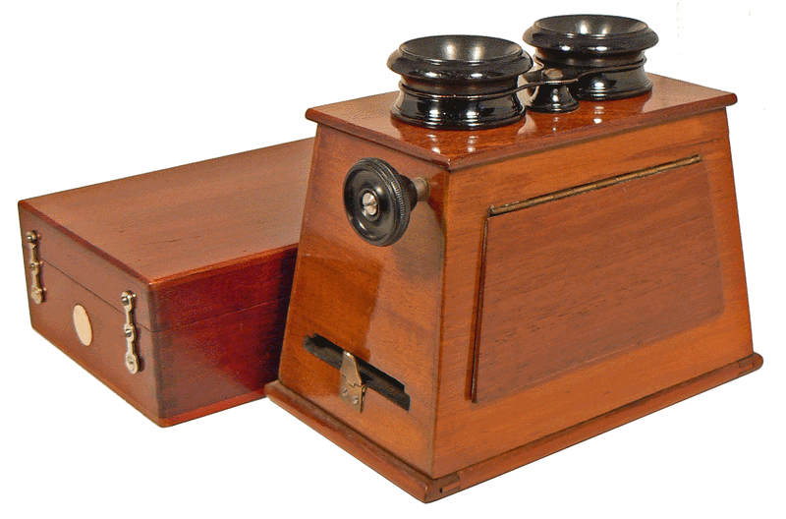
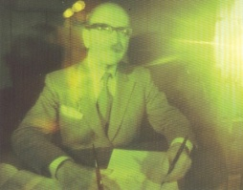
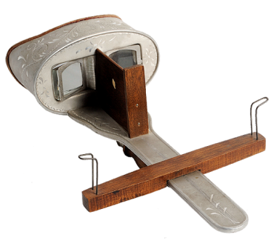
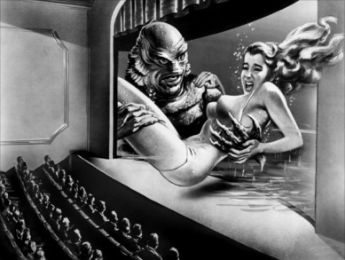
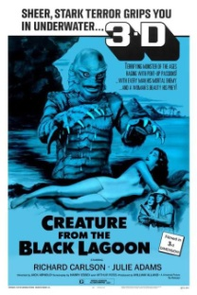
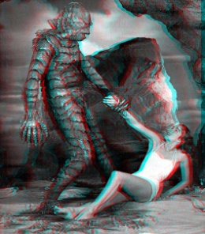
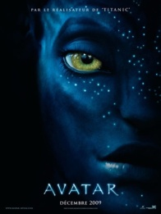
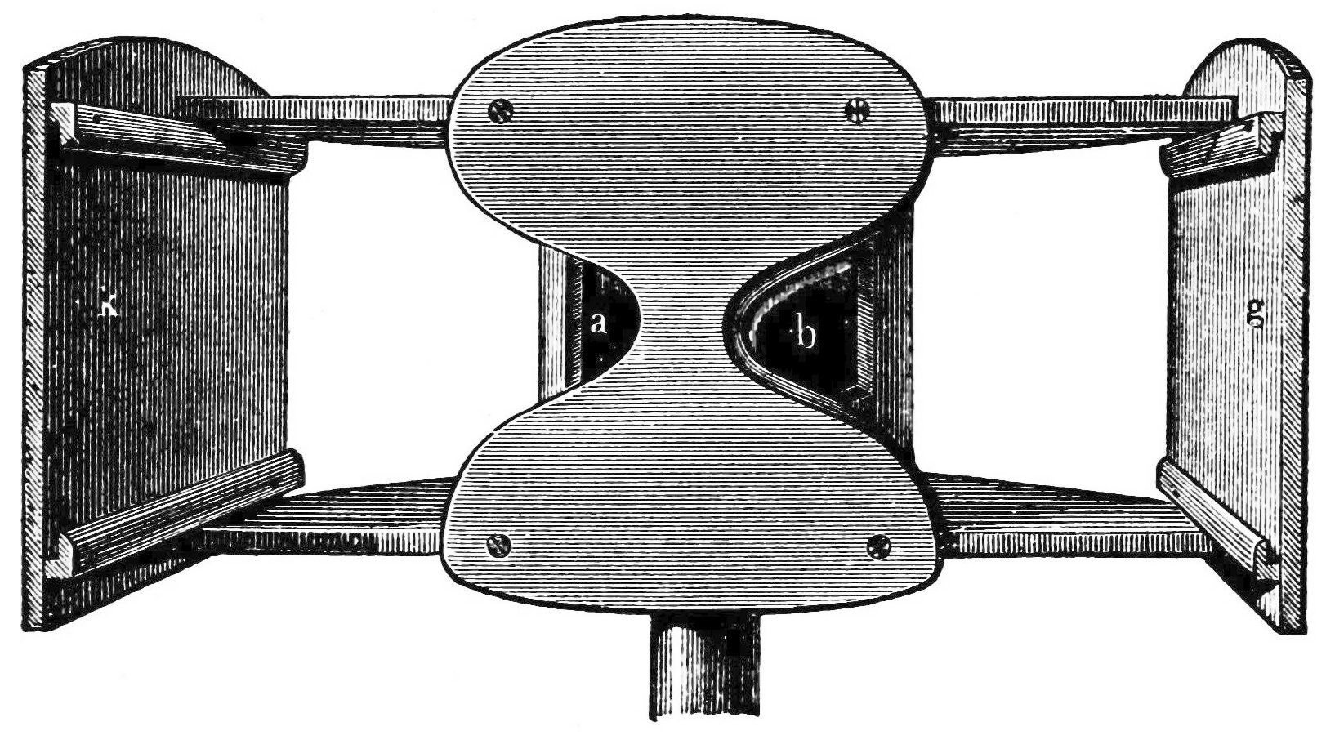
A short history
1877
1908
1948
1981
1993
Télétroscope
Black and White
TV
Color
TV
HDTV
Digital TV
Satellite TV
Gaumont,1910
Brewster & Duboscq , 1838
Digital era
3DTV
Holmes, 1860
1838
1908
1948
1952
1986
… 1^{st wave} ][ 2nd wave ][ 3rd wave ][ 4th wave …
Stereoscope
Integral
Photography
Holography
3D cinema
IMAX
3D DVD
…
Wheatstone, 1838
http://www.antiq-photo.com

Slide 7
Overview
Content of the immersive 3D point cloud: acquisition and processing approaches
i. Acquisition systems
ii. 3D reconstruction
iii. High Dynamic Range (HDR)
From video to
i. 3D point cloud
ii. 3D video
iii. 3D HDR video
Current limitations and challenges

Slide 8
Classification of methods
Time
Video
HDR Video
3D Video
2D Image
HDR
Image
3D Image
Exposition
Viewpoint

Slide 9
Overview
Content of the immersive 3D point cloud: acquisition and processing approaches
i. Acquisition systems
ii. 3D reconstruction
iii. High Dynamic Range (HDR)

Slide 10
Acquisition of 3D point clouds
Use of a multiview acquisition system
What is it? What is it for ?
Composed of several cameras
To represent a same scene at a given time from several viewpoints
How many cameras?
Which configuration?

Slide 11
Different multiview acquisition systems
Why taking several shots of a same scene?
3D visualization of captured videos
Real scene reconstruction
2.5D reconstruction (depth)
3D reconstruction w/wo texture (digital models)
MoCap (movement) – used for animation
Image compositing (adjustments/lighting)
Mosaicking (panorama or High-Res image)
Frozen time or bullet time
AR
FVV
Refocus

Slide 12
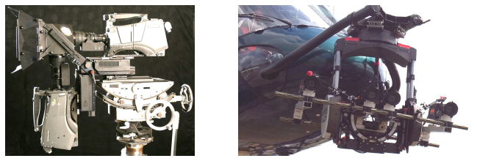
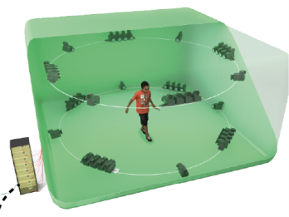
Different multiview acquisition systems
Binocular systems
Stereoscopic RIG
Multiview systems
Lateral or directional
Linear or grid (Camera Array)
Plenoptic
Encompassing or omnidirectional
Other infrared systems

Slide 13
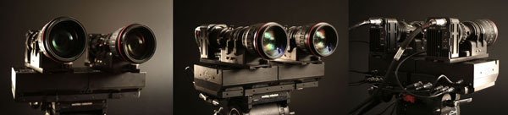
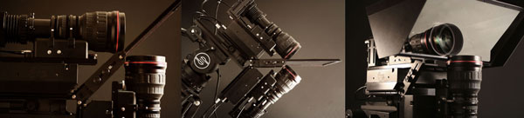
Binocular systems
Stereoscopic rig: two cameras connected by a rigid or articulated device
Binocular video refers to stereoscopy
Use of stereo correspondences to extract depth information
The shooting geometry is linked to epipolar geometry
Rigs from Binocle (http://www.binocle.com/)

Slide 14
Lateral or directional multiview systems
Three or more cameras
Associated to multistereoscopy
Evenly distributed along a curve or a grid
Mechanical assembly (linear or matricial)
Synchronization using specific electronics
Target content (FVV, 3D reconstruction, 3D visualization, refocus, …) impacts on
The number of cameras needed
Their spatial organization

Slide 15
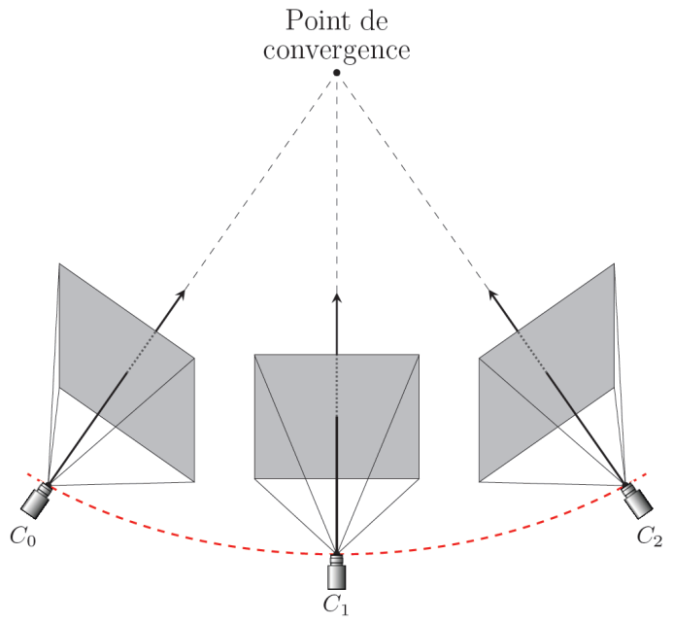
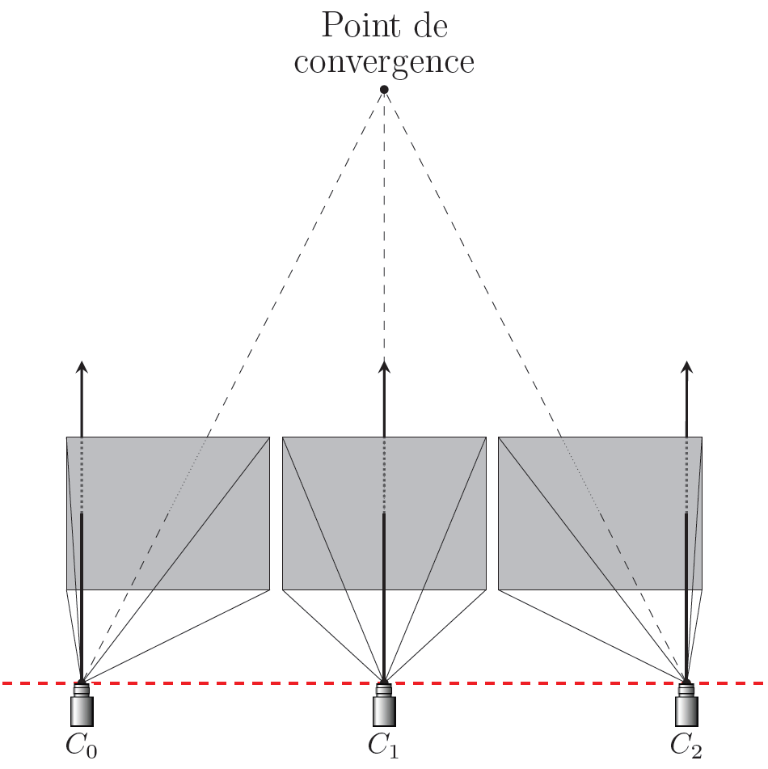
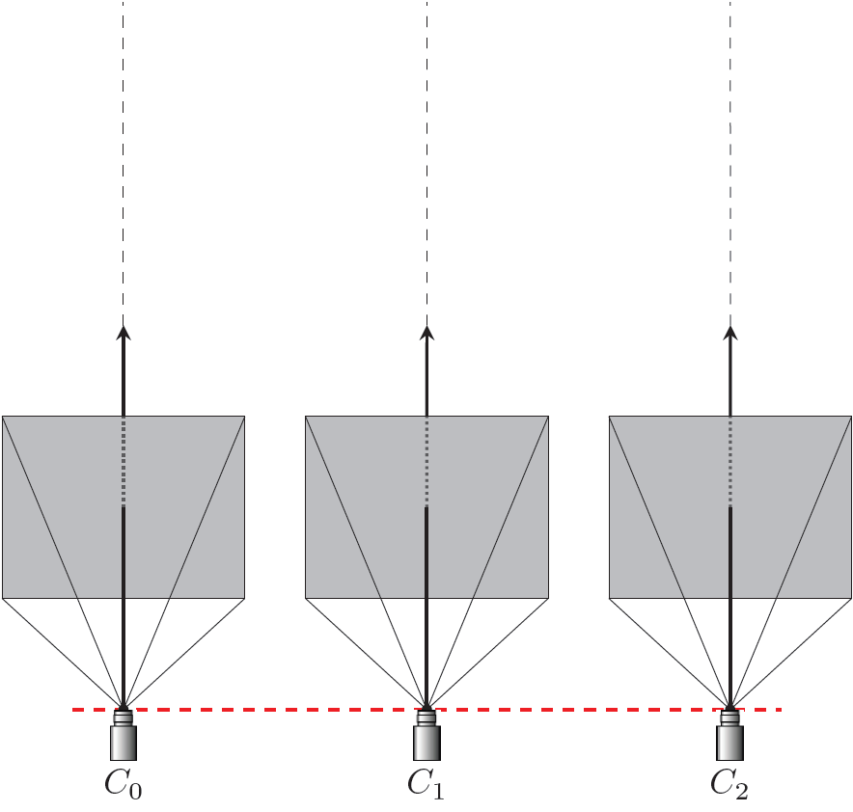
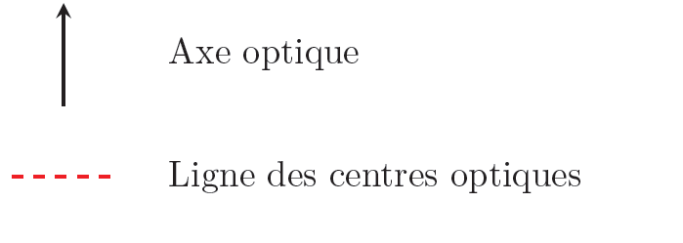
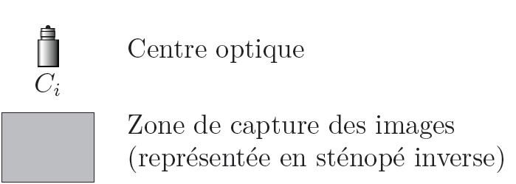
Camera models
3 types of geometry of multiview capture
Converging geometry
Parallel geometry
Off-axis parallel geometry
Focal point
Focal point
Optical axis
Optical center
Lines of optical centers
Capture area of images (in inverse stenope)

Slide 16
Camera arrays vs. plenoptic systems
Camera arrays
Capture multiple images with significant resolution for depth and 3D reconstruction, or Interactive visualization
Plenoptic systems
Capture lightfield for FVV (interpolated views), or refocus and can be used for depth reconstruction

Slide 17
Different multiview acquisition systems
Systems | Binocular | Lateral/directional multiview | Global/Omnidirectional
3D video visualization | X | X
2.5D/depth | X | X
3D modeling |  | X | X
MoCap |  |  | X
Compositing | X | X | X
Mosaicking |  | X
Frozen time |  | X | X
Bullet time |  |  | X
AR | X | X | X
FVV |  | X | X
Refocus |  | X

Slide 18
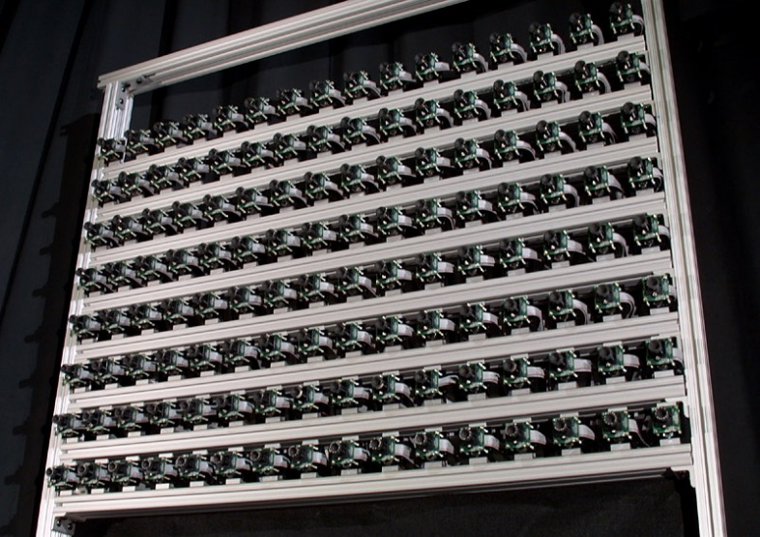
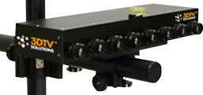
How many cameras?
The 8-objective camera in CReSTIC
The standford Camera Array (128 cameras)

Slide 19
Global or omnidirectional systems
Objective: enough to model animated content (objects and/or actors)
A scene volume large enough
Redundancy for reconstruction
Number and position of cameras depend on the objective
Lateral/top/bottom for 3D reconstruction
Trajectory for frozen time
Layouts: several circles, corners, outside setups, …
Number varies from a few to several hundreds!

Slide 20
Global systems
Global systems for bullet/frozen time or slow motion effects
Multiview system used in the matrix
120 still cameras
2 video cameras enabling time slicing

Slide 21
Omnidirectional systems

Slide 22
Difficulties with such systems
Synchronization and calibration is a hard step
Need of a lot of precision
Must have capabilities
Networking
Storage
Computation
Large video streams

Slide 23
Conclusion
Multiview systems differ on
Their number of cameras
The layout of the cameras
They serve different purposes but share the same difficulties in
Synchronization
Calibration
Video stream
Which get higher when the occupied space and the number of camera become larger

Slide 24
Overview
Content of the immersive 3D point cloud: acquisition and processing approaches
i. Acquisition systems
ii. 3D reconstruction
iii. High Dynamic Range (HDR)
Time
Video
3D Video
HDR
Image
3D Image
Exposition
Viewpoint

Slide 25
3D reconstruction approaches
Stereovision – epipolar geometry
Multiscopic system – disparity estimate
Volume reconstruction – visual hull

Slide 26
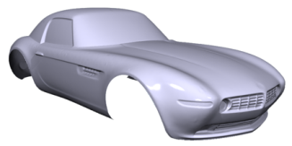

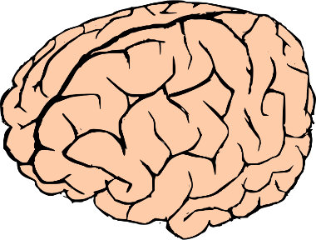
Introduction to stereovision
Computer mimicry of human stereopsis
digital 3D partial surface
3D object
Perceived 3D partial surface
…
…
stereovision
stereopsis

Slide 27
Introduction to stereovision
Refresh on stereopsis : 2 steps
Matching: detection of inter-view homologous pixels
Triangulation: perceived 3D points lie at eye-pixel rays intersection
Matching is the hard step, even for HVS Triangulation, innate for HV, relies on precise calibration Epipolar constraint is a must-use key guide.
Geometric « epipolar constraint » + Photo-consistency of views content
Epipolar constraint ensures intersection Innate knowledge of ray geometry…

Slide 28
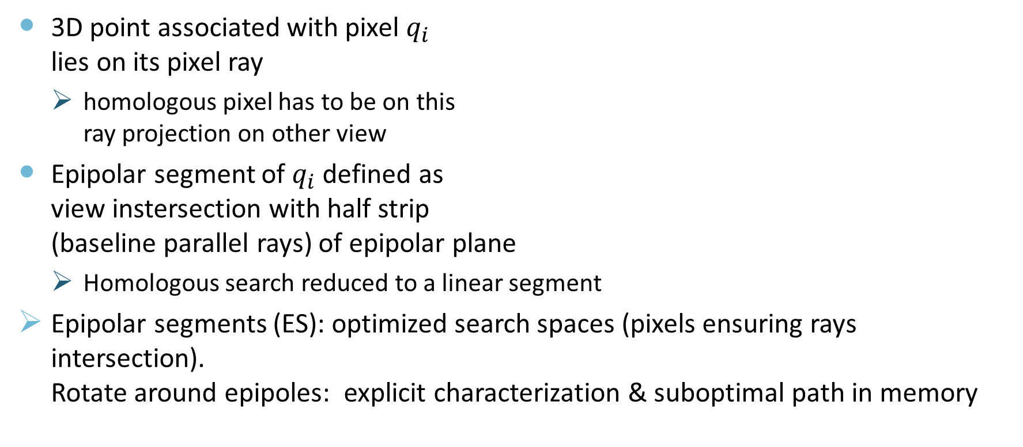
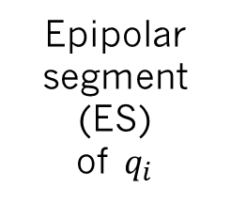
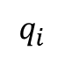
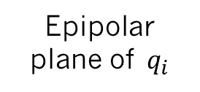
Use of epipolar constraint
Epipolar plane of $q_{i}$
3D point associated with pixel $q_{i}$ lies on its pixel ray
homologous pixel has to be on this ray projection on other view
Epipolar segment of $q_{i}$ defined as view instersection with half strip (baseline parallel rays) of epipolar plane
Homologous search reduced to a linear segment
Epipolar segments (ES): optimized search spaces (pixels ensuring rays intersection). Rotate around epipoles: explicit characterization & suboptimal path in memory
$$q_{i}$$
Epipolar segment (ES) of $q_{i}$
Epipole Optical center

Slide 29

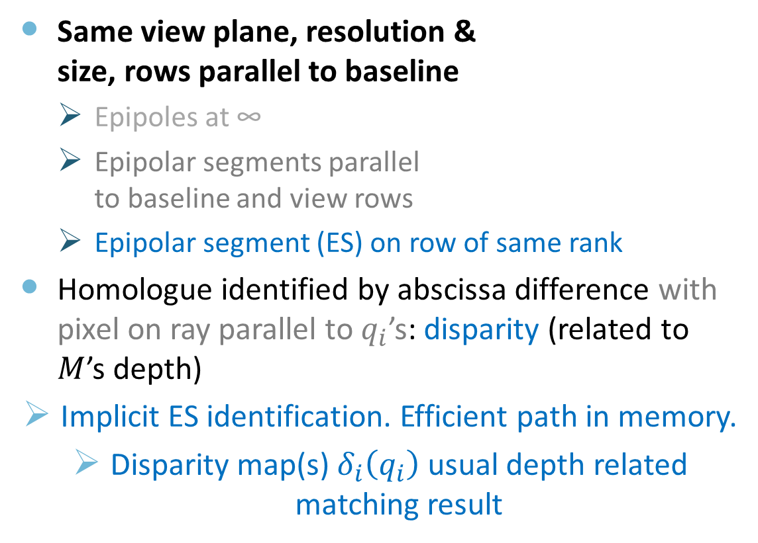
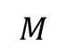
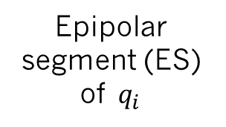
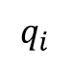
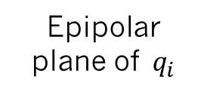
Use of simplified epipolar geometry
Same view plane, resolution & size, rows parallel to baseline
Epipoles at ∞
Epipolar segments parallel to baseline and view rows
Epipolar segment (ES) on row of same rank
Homologue identified by abscissa difference with pixel on ray parallel to $q_{i}$’s: disparity (related to $M$’s depth)
Implicit ES identification. Efficient path in memory.
Disparity map(s) $δ_{i}\left(q_{i}\right)$ usual depth related matching result
$$M$$
Epipolar plane of $q_{i}$
$$q_{i}$$
Disparity
$$δ+δc≥0$$
$$δc={ku}^{s}b^{s}$$
Epipolar segment (ES) of $q_{i}$

Slide 30
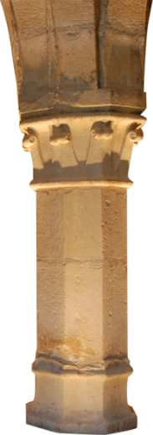
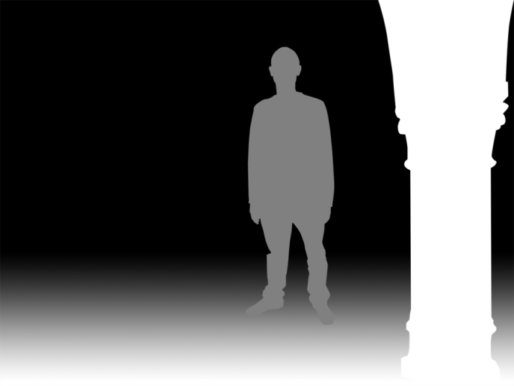
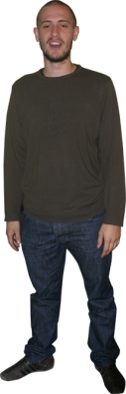
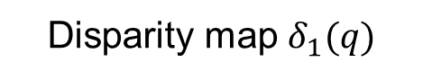
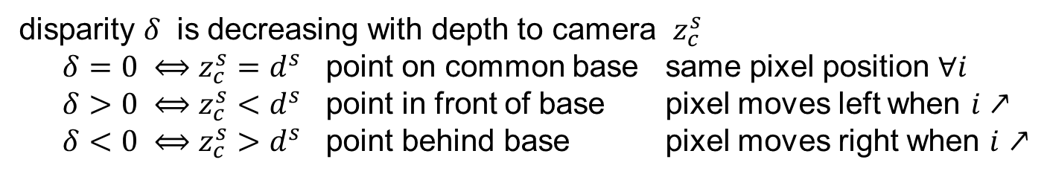
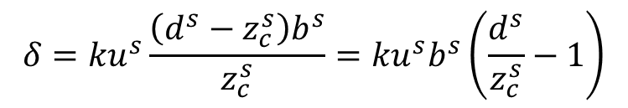
Disparity vs. Depth
Geometrical relation
Disparity map $δ_{1}(q)$
$$δ={ku}^{s}\frac{\left(d^{s}−z_{c}^{s}\right)b^{s}}{z_{c}^{s}}={ku}^{s}b^{s}\left(\frac{d^{s}}{z_{c}^{s}}−1\right)$$
disparity $δ$ is decreasing with depth to camera $z_{c}^{s}$
$δ=0 ⟺z_{c}^{s}=d^{s}$ point on common base same pixel position $∀i$
$δ>0 ⟺z_{c}^{s}<d^{s}$ point in front of base pixel moves left when $i↗$
$δ<0 ⟺z_{c}^{s}>d^{s}$ point behind base pixel moves right when $i↗$

Slide 31
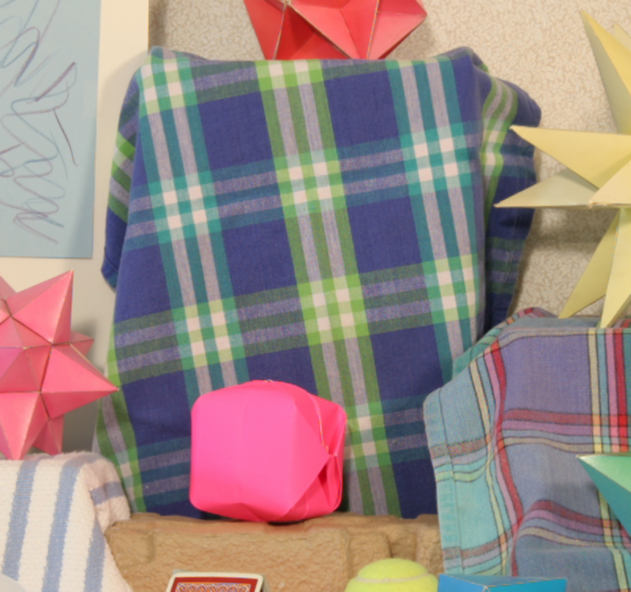
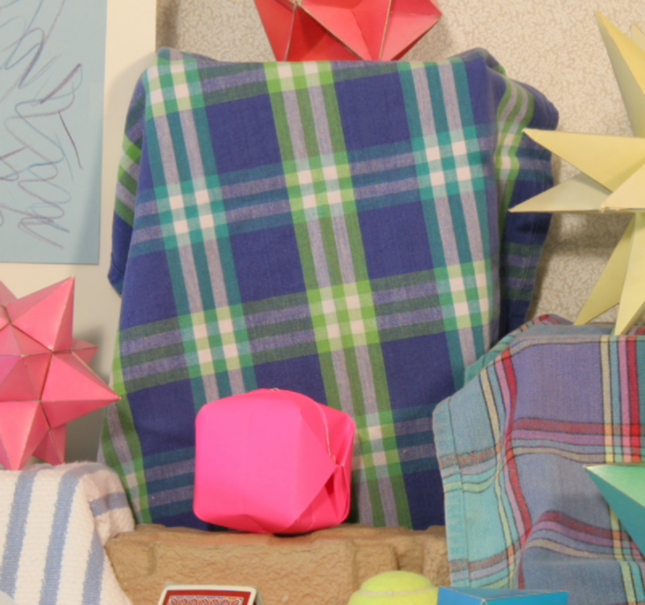
Stereo-matching: Photo-consistency issues
??
??
Low texture
Repeated texture
Ambiguity
Depth discontinuity
Specular effect
Misleading dissimilarity
Occlusions
Incomplete
matching

Slide 32
Stereo-matching
Summary of major sets of methods
Local pixel matching:
Very sensitive to similarity issues.
Primitive matching:
pre-extracted primitives (regions, borders…) matched according to shape & photo consistencies
Lesser influence of similarity issues
Primitive issues: robustness, inter-view consistency.
Global matching:
Poor occlusion handling

Slide 33
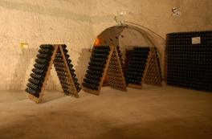
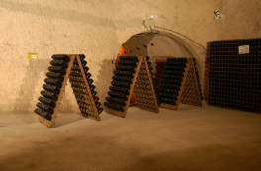
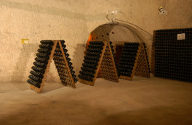









Multi-stereovision
Simplified multi-epipolar geometry
Combining pairwise simplified epipolar geometries
same view plane resolution & size for all views, rows of each view parallel to a (thus common) baseline ► aligned centers.
Common pairwise epipolar planes; Homologous pixels on row of same rank in each view
Option: evenly distributed centers ► equal disparity values for each pair
$$M$$
Epipolar plane of $q_{i}$
$$q_{i}$$
Disparity
ES of $q_{i}$
$δ_{i}+{δc}_{i}≥0$ ${δc}_{i}={ku}^{s}b_{i}^{s}$
ES of $q_{i}$

Slide 34




Multi-stereovision
Enhancing redundancy to tackle ambiguities
Multiscopic coherent pixels set (one per View)
Pairwise compatible with epipolar constraints
$$\left\{…,q_{i−1},q_{i},q_{i+1},…\right\}$$
Photo-consistency has to be redundant within each pair failure indicates bad match or occlusion
Enhanced robustness & ability to use visibility reasoning
$$M$$
Epipolar plane of $q_{i}$
$$q_{i−1}$$
$$q_{i}$$
$$q_{i+1}$$
$$δ+δc≥0 δc={ku}^{s}b^{s}$$
Photo-consistency ?

Slide 35





Some multi-stereovision results
Extracting a point cloud
Surface reconstruction

Slide 36
Other type of multiview reconstruction
Visual hull estimate

Slide 37

Conclusion
From stereovision to multistreovision
Epipolar geometry
… to disparity
Different camera geometry
Help defining simplified methods
Matching is a difficult problem
Linked to scene content

Slide 38
Overview
Content of the immersive 3D point cloud: acquisition and processing approaches
i. Acquisition systems
ii. 3D reconstruction
iii. High Dynamic Range (HDR)
Time
Video
HDR Video
3D Video
HDR
Image
3D Image
Exposition
Viewpoint

Slide 39






HDR imaging
Expending the dynamic range of image intensity
Objective: get as close as possible to eye perception (20 stops)
Limitation: camera sensors

Slide 40






HDR acquisition using different exposures
Static scenes + same viewpoint
Weighted average of images acquired with different exposure times from the same viewpoint [Debevec97]
Exposure fusion [Mertens07]
HDR output
LDR input
Notes:
Depending on the type of scenes, different methods exist for acquiring HDR images.
Some methods allow the acquisition of static scenes from a same viewpoint.
From multiple exposure images, it is possible to reconstruct an HDR image either with a weigthed average or exposure fusion.
Instead of using a multiple images, it is possible to put an optical mask directly inside the camera to simulate multiple exposures in one shot.

Slide 41




HDR acquisition using different exposures
Static scenes + same viewpoint
Weighted average of images acquired with different exposure times from the same viewpoint [Debevec97]
Exposure fusion [Mertens07]
[Mertens07]
Notes:
Depending on the type of scenes, different methods exist for acquiring HDR images.
Some methods allow the acquisition of static scenes from a same viewpoint.
From multiple exposure images, it is possible to reconstruct an HDR image either with a weigthed average or exposure fusion.
Instead of using a multiple images, it is possible to put an optical mask directly inside the camera to simulate multiple exposures in one shot.

Slide 42


Problems with HDR reconstruction

Slide 43



HDR acquisition
Dynamic scenes with small movement
Reconstruction without the objects in movement [Granados08]
Reconstruction with the objects in movement
Detection of the movement [Sand04, Grosch06, Jacobs08, Gallo09]
Probability for a pixel to belong to a static part of the image [Khan06, Pedone08]
Intensity mapping combined with mutual information or normalized cross-correlation for local warping [Ramirez12]
Granados08
Input images
Computed labeling
Estimated background
Notes:
Other methods exist for the acquisition of dynamic scenes with small movement.
Granados et al. develop a method that allows the background reconstruction without the objects in movement in the final HDR image.
For the reconstruction with the object in movement in the final HDR image, others propose to detect the movement in the scene or to compute the probability for a pixel to belong to a static part of the image.
With these methods there is no guarantee to have the dynamic objects in the final image.

Slide 44


HDR acquisition
Dynamic scenes with small movement
Reconstruction without the objects in movement [Granados08]
Reconstruction with the objects in movement
Detection of the movement [Sand04, Grosch06, Jacobs08, Gallo09]
Probability for a pixel to belong to a static part of the image [Khan06, Pedone08]
Intensity mapping combined with mutual information or normalized cross-correlation for local warping [Ramirez12]
Whole HDR image from a dynamic scene [Ramirez12]
Notes:
Other methods exist for the acquisition of dynamic scenes with small movement.
Granados et al. develop a method that allows the background reconstruction without the objects in movement in the final HDR image.
For the reconstruction with the object in movement in the final HDR image, others propose to detect the movement in the scene or to compute the probability for a pixel to belong to a static part of the image.
With these methods there is no guarantee to have the dynamic objects in the final image.

Slide 45

HDR acquisition
Dynamic scenes with small movement
Reconstruction without the objects in movement [Granados08]
Reconstruction with the objects in movement
Detection of the movement [Sand04, Grosch06, Jacobs08, Gallo09]
Probability for a pixel to belong to a static part of the image [Khan06, Pedone08]
Intensity mapping combined with mutual information or normalized cross-correlation for local warping [Ramirez12]
One shot: use of a mask inside the camera [Nayar00]
Optical mask [Nayar00]
Notes:
Other methods exist for the acquisition of dynamic scenes with small movement.
Granados et al. develop a method that allows the background reconstruction without the objects in movement in the final HDR image.
For the reconstruction with the object in movement in the final HDR image, others propose to detect the movement in the scene or to compute the probability for a pixel to belong to a static part of the image.
With these methods there is no guarantee to have the dynamic objects in the final image.

Slide 46










HDR video acquisition
Dynamic scenes with changes in the whole scene
Two exposure times for each frame [Kang03]
Devices
HDR cameras [Tocci11, SpheronCamHDR11]
[Tocci11]
HDR Spheron camera
Kang03
Notes:
One can consider changes in the whole scene.
For this Kang et al. change exposure times between each frame and use optical flow to retrieve HDR values.
Others compute stereo HDR images from images acquired from two viewpoints with two exposure times.
This algorithm is the closest to ours.
At the current state of our work, we believe that our algorithm performs better when more than two images are used.
Some devices exist to acquire directly HDR videos but these devices are still at an experimental stage.

Slide 47
Conclusion
HDR Imaging got many different proposals of methods
First, HDR processing for static scenes
Second, HDR processing to detect movement
Third, HDR video processing
New devices
Dedicated sensors
Dedicated capture process

Slide 48
Overview
Content of the immersive 3D point cloud: acquisition and processing approaches
i. Acquisition systems
ii. 3D reconstruction
iii. High Dynamic Range (HDR)
From video to …
i. 3D point cloud
ii. 3D video
iii. 3D HDR video

Slide 49
Overview
Content of the immersive 3D point cloud: acquisition and processing approaches
i. Acquisition systems
ii. 3D reconstruction
iii. High Dynamic Range (HDR)
From video to …
i. 3D point cloud
ii. 3D video
iii. 3D HDR video

Slide 50


Multi-types multiview systems
Monoscopic units
Example: the RECOVER3D system
Multiscopic system
Notes:
Pour atteindre l’objectif, Solutions proposées dans le cadre de la these
Une nouvelle configuration du studio de capture. Nous avons proposé de utliser deux type de camera. Le prmier , nous l’applons unité monscopose qui contient un seul camera. Et multiscopique qui est compse de 4 camera avec centre optique alignee et axes optix convergent.
Grace a notre systeme d’acquetion nous proposon une méthodologie hybride de reconscton tion en utilisant L’envelope visuelle et la stereovision multi-occulair.
ATTENTION Ici : donner la definition d’une envelope visuelle et de la stéréovision
Enveloppe visuelle : decoupage d’une volume par definition d’un espace commun de toutes les pyramides des points de vue des cameras du studio ominidirectionel
Stéréovision : reconstruction par couple de caméras par mise en correspondence
Stéréovision multi-oculaire : élargissement de la stereovision à n caméras (n >2)

Slide 51

Stereovision guided by visual hull
Initialize the bouding box
Choose a voxel on the surface
Projet onto camera image planes if visible
Carve if not photo-coherent
Repeat until convergence
Space Carving initialized by visual hull[Kutulakos et al. 2000]
Image 1
Image N
…...
Kiriakos N. Kutulakos and Steven M. Seitz, A theory of shape by space carving, Int. J. Comput. Vision 38 (2000), no. 3, 199–218.
Notes:
Dans la premier catégorie, nous classon la methode de spece carving intisalisé par l ’envelope visuelle proposé par kutulakos et al 2000
Dans cette methode, tout d’abord on initliser l’enveloppe visuelle et ensuite on choisir un voxel sur la surface . On projet ce voxel sur les plans images des cameras pour les quelles il est visible.
Ensuite, on crusur ce voxel si non photo-cohérence.
On repeter les etapes 2 à 4 jusqu’à convergence.

Slide 52

Stereovision guided by visual hull
Initialize the bouding box
Choose a voxel on the surface
Projet onto camera image planes if visible
Carve if not photo-coherent
Repeat until convergence
Space Carving inilialisé par enveloppe visuelle [Kutulakos et al. 2000]
Image 1
Image N
…...
+ Fast approach – good for real time constraints
- Resolution lower than with stereovision
Kiriakos N. Kutulakos and Steven M. Seitz, A theory of shape by space carving, Int. J. Comput. Vision 38 (2000), no. 3, 199–218.
Notes:
Dans la premier catégorie, nous classon la methode de spece carving intisalisé par l ’envelope visuelle proposé par kutulakos et al 2000
Dans cette methode, tout d’abord on initliser l’enveloppe visuelle et ensuite on choisir un voxel sur la surface . On projet ce voxel sur les plans images des cameras pour les quelles il est visible.
Ensuite, on crusur ce voxel si non photo-cohérence.
On repeter les etapes 2 à 4 jusqu’à convergence.

Slide 53
Stereovision guided by visual hull
[Ming Li et al. 2002]
Use minmal and maximum bound for the visual hull
Max depth
Min depth
Ming Li, H. Schirmacher, M. Magnor, and H.-P. Siedel, Combining stereo and visual hull information for on-line reconstruction and rendering of dynamic scenes, Multimedia Signal Processing, 2002 IEEE Workshop on, December 2002, pp. 9 – 12.
Notes:
Une autre méthode peut se classer dans la premier catogire, c’est la stereovision guider silhouette méthode proposée par Ming li et al. dans cette méthode on calcule l’enveloppe visuelle afin de restreindre la plage de disparity.

Slide 54
Stereovision guided by visual hull
[Ming Li et al. 2002]
Use minmal and maximum bound for the visual hull
Max depth
Min depth
+ Better resolution
- Limited for non textured or uniform areas
Ming Li, H. Schirmacher, M. Magnor, and H.-P. Siedel, Combining stereo and visual hull information for on-line reconstruction and rendering of dynamic scenes, Multimedia Signal Processing, 2002 IEEE Workshop on, December 2002, pp. 9 – 12.
Notes:
Une autre méthode peut se classer dans la premier catogire, c’est la stereovision guider silhouette méthode proposée par Ming li et al. dans cette méthode on calcule l’enveloppe visuelle afin de restreindre la plage de disparity.

Slide 55


Fusion of stereovision and visual hull
Fusion using a deforming method[Esteban et al. 2004]
Initialisation
Result
Model deformation (i.e. snake) to get a mesh as close as possible to the object surface
Visual hull
Deformed model
Carlos Hernández Esteban and Francis Schmitt, Silhouette and stereo fusion for 3D object modeling, Computer Vision and Image Understanding 96 (2004), no. 3, 367–392.
Notes:
Dans la deuxime catogrie, estaban et al en 2004 propose de fusion les deux methodes en utilisant une méthode de déformation snake pour obtiner le maillage le plus proche possible de la surface réel de l’objet.

Slide 56
Fusion of stereovision and visual hull
Fusion using a deforming method[Esteban et al. 2004]
Initialisation
Result
Model deformation (i.e. snake) to get a mesh as close as possible to the object surface
+ High resultion and good modeling on low texture areas and concave surfaces
- Very time consuming (3 hours)
Visual hull
Deformed model
Carlos Hernández Esteban and Francis Schmitt, Silhouette and stereo fusion for 3D object modeling, Computer Vision and Image Understanding 96 (2004), no. 3, 367–392.
Notes:
Dans la deuxime catogrie, estaban et al en 2004 propose de fusion les deux methodes en utilisant une méthode de déformation snake pour obtiner le maillage le plus proche possible de la surface réel de l’objet.

Slide 57




Two separate methods and fusion
Fusion of two 3D point clouds [Song et al. 2010]
Volumic visual hull
Estimate of depth range
Multi-Stéréovision
Transformation to a 3D point cloud
3D point cloud by multisterovision
Fusion of 3D point clouds
Peng Song, Xiaojun Wu, and Michael Wang, Volumetric stereo and silhouette fusion for image-based modeling, The Visual Computer 26 010), no. 12, 1435–1450.

Slide 58
Fusion of two stereovision approaches
Fusion of two 3D point clouds [Song et al. 2010]
Volumic visual hull
Estimate of depth range
Multi-Stéréovision
Transformation to a 3D point cloud
+ High resolution modeling adapted to low texture areas and concave surfaces
- Limited scene space
3D point cloud by multisterovision
Fusion of 3D point clouds
Peng Song, Xiaojun Wu, and Michael Wang, Volumetric stereo and silhouette fusion for image-based modeling, The Visual Computer 26 010), no. 12, 1435–1450.

Slide 59








Fusion of two approaches
Fusion of depth data with viusal hull [Narayan et al. 2015]
Images RGB
Fusion of depth maps
Visual Hull
Visual hull guided improvement
Narayan, K., Sha, J., Singh, A., and Abbeel, P. (2015). Range sensor and silhouette fusion for high-quality 3d scanning. In Robotics and Automation (ICRA), 2015 IEEE International Conference on, pages 3617–3624.
Notes:
Dans le troisem group, nous povons aussi mettre la methodes de Narayan et al propose en 2015 et qui ont unlisé les camera Kienct de leur acquistion. Leur objectifiver est de reconstructruire l’object transparant et concave en fusionnant le mailliage issu de l’enveloppe visuelle et celle de la crte de profondeur.

Slide 60
Fusion of two approaches
Fusion of depth data with viusal hull [Narayan et al. 2015]
Images RGB
Fusion of depth maps
Visual Hull
Visual hull guided improvement
+ Deals with transparent objects
- Limited by the depth sensor scene space
Narayan, K., Sha, J., Singh, A., and Abbeel, P. (2015). Range sensor and silhouette fusion for high-quality 3d scanning. In Robotics and Automation (ICRA), 2015 IEEE International Conference on, pages 3617–3624.
Notes:
Dans le troisem group, nous povons aussi mettre la methodes de Narayan et al propose en 2015 et qui ont unlisé les camera Kienct de leur acquistion. Leur objectifiver est de reconstructruire l’object transparant et concave en fusionnant le mailliage issu de l’enveloppe visuelle et celle de la crte de profondeur.

Slide 61

Hybrid 3D reconstruction
Muhannad Ismael, Yannick Remion, Stéphanie Prévost, Céline Loscos
PhD thesis – RECOVER 3D Project
Monoscopic cameras
Hybrid reconstruction
Visual hull
Multiview stereovision
Multiview point stereovision
Multiscopic cameras
4 convergent aligned cameras

Slide 62


Guiding stereovision by visual hull
Volumic space
Epipolar plane
Disparity space
Initial visual hull
-2
In VH
-1
0
1
Notes:
C’est-à-dire, nous projet l’enveloppe visuelle dans notre espace de disparity, et tout les point cible qui sont hore l’enveloppe visuelle ne rentre pas dans la process d’optimisation de la carte de materialité

Slide 63




Guiding stereovision by visual hull
Stereovision results
Filtered by VH
Cédric
Notes:
Les resultat montre que l’utlisation de l’enveloppe visuelle nous permet d’enlever les outlier (les zones entrour par le rectangle rouge)et d’une autre cote permet de construire une surface plus preceis comme nous le noter dans les zone entroure par les rectangle bleu et vert.

Slide 64






Guiding stereovision by visual hull
Initial VH
Carved VH
Carved point cloud by VH
Simon (virtual actor)
Philippe (real actor)

Slide 65




Multiview fusion
Multiscopic carved models
Fusion result

Slide 66












Multiview fusion
Simon (virtual actor)
Jacques (real actor)
Notes:
Si on suporposer les deux coupes, on va se trouverez avec des zones qui ont les meme indiqueateurs (surface). Par contre, ce que va poser le porblemes ce les zones inchorence entre les deux volumes creusée

Slide 67


Multiview fusion
25 fps, 3 multiscopic cameras
Notes:
Si on suporposer les deux coupes, on va se trouverez avec des zones qui ont les meme indiqueateurs (surface). Par contre, ce que va poser le porblemes ce les zones inchorence entre les deux volumes creusée

Slide 68
Overview
Content of the immersive 3D point cloud: acquisition and processing approaches
i. Acquisition systems
ii. 3D reconstruction
iii. High Dynamic Range (HDR)
From video to…
i. 3D point cloud
ii. 3D video
iii. 3D HDR video

Slide 69




Problematic
Static mesh sequence
No temporal coherence
Not adapted to 3D video and postproduction
Objective: coherent animated model

Slide 70



Model-based approaches
Reference model adapted to an actor anatomy
Movement tracking without sensors
Animation limited by the model (skeleton animation, parametric surfaces …)
Kehl and Gool 2006 [75]
Gall et al. 2009 [61]
Aguiar et al. 2008 [47]

Slide 71


Model-based approaches
Unique deformable surface
Aligned with succesiv poses from multiview capture
Difficulty in linking a set of static objects with a unique geometry
Starck and Hilton 2007 [140]
Cagniart et al. 2010 [33]
Li et al. 2012 [90]

Slide 72





Model-free approaches: example in the RECOVER 3D project
Images
Cameras
Reconstruction

Slide 73






Process steps
Mesh $t$ and v$isual hull t$+1
Motion flow
Anchors
Global deformation
Local optimisation

Slide 74
Results
Sequence of original meshes
Temporaly coerent mesh
Tracking of the targeted surface
Adaptated to non rigid movments
Visual quality independant of ta given model

Slide 75


Results
Unique textured animated model
UV map

Slide 76


Results
Integration in a virtual scene and interaction

Slide 77
Conclusion
3D video needs scene understanding
Manipulation
Freeview point visualisation
Enhancement
Recent approaches go one step into this direction

Slide 78
Overview
Content of the immersive 3D point cloud: acquisition and processing approaches
i. Acquisition systems
ii. 3D reconstruction
iii. High Dynamic Range (HDR)
From video to…
i. 3D point cloud
ii. 3D video
iii. 3D HDR video

Slide 79
Classification of methods
Time
Video
3D HDR Video
HDR Video
3D Video
3D HDR Image
2D Image
HDR
Image
3D Image
Exposition
Viewpoint

Slide 80

3D HDR Video
HDR
DEPTH
3D HDR

Slide 81
General pipeline for HDR imaging
Set of differently exposed images
Matching/Registration
HDR Reconstruction
I₀
E₀
I₀
P
(i₀,j₀)
I_{i}
I_{i}
E_{i}
P
(i_{i},j_{i})
I_{n}
P
(i_{n},j_{n})
I_{n}
E_{n}

Slide 82
General pipeline for HDR imaging
Single viewpoint
Static scenes
Image alignment
Dynamic scenes
Identification of motion
Dynamic object removal
Registration of objects in movement
Multiscopic images
Pixel matching using
Belief propagation [LIN 09]
3D estimation [LU 11]
Disparity [BONNARD 12]
Patch based [RAMIREZ 15]
Set of differently exposed images
Matching/Registration
HDR Reconstruction
I₀
E₀
I₀
P
I_{i}
(i₀,j₀)
Image
I_{i}
E_{i}
(i_{i},j_{i})
P
I_{n}
(i_{n},j_{n})
P
I_{n}
E_{n}

Slide 83
General pipeline for HDR imaging
HDR Reconstruction
Weighted average
Exposure fusion [Mertens07]
Set of differently exposed images
Matching/Registration
HDR Reconstruction
I₀
E₀
I₀
P
I_{i}
(i₀,j₀)
Image
I_{i}
E_{i}
(i_{i},j_{i})
P
I_{n}
(i_{n},j_{n})
P
I_{n}
E_{n}
LDR input
HDR output
Notes:
Depending on the type of scenes, different methods exist for acquiring HDR images.
Some methods allow the acquisition of static scenes from a same viewpoint.
From multiple exposure images, it is possible to reconstruct an HDR image either with a weigthed average or exposure fusion.
Instead of using a multiple images, it is possible to put an optical mask directly inside the camera to simulate multiple exposures in one shot.

Slide 84










Multiview acquisition [BONNARD 12]
Simultaneous acquisition of several exposures from different viewpoints
Real exposure time = 40 ms
d = 0.3
d = 0.9
d = 0.6
d =0
d =0
d = 0.3
d = 0.9
d = 0.6
$∆t≈$ 40, 20, 10 or 5 ms
Notes:
We use 2 pairs of 3 different filters that leads us with 2 pairs of 4 different exposures.
An example is shown on the slide.

Slide 85








Pixel matching [BONNARD 12]
Use of disparity
LDR images
M
Scene 3D points

Slide 86








HDR merge [BONNARD 12]
M
LDR images
Scene 3D points
Resutling HDR images

Slide 87









Results [BONNARD 12]
Middlebury
CG
OctoCam
Original images
Disparity maps
Tone mapped HDR images
Notes:
We tested our method on input images generated differently: Middlebury images, images generated using a raytracer and images acquired with the OctoCam.
The second row shows disparity maps associated to the matches.
The third row is the result that we obtained for the generation of the HDR image from a unique viewpoint.

Slide 88
Patch-based 3D HDR images [Ramirez 15]
Random search guided by the epipolar line

Slide 89
Conclusion
HDR can be added to 3D imaging
[Bonnard 12] based on disparity estimation
Possibility of using 3D HDR content
For display: no 3D HDR display exists!
Tone mapped for 3D displays
Area of research 3D HDR video tone mapping!
Stereo output on HDR displays
For simulation content
Storage format?
Perspectives
Extension to 3D HDR video
Temporal consistency

Slide 90
Overview
Content of the immersive 3D point cloud: acquisition and processing approaches
i. Acquisition systems
ii. 3D reconstruction
iii. High Dynamic Range (HDR)
From video to
i. 3D point cloud
ii. 3D video
iii. 3D HDR video
Current limitations and challenges

Slide 91
Current limitations and challenges
Only raw data – need of a post-process for
Artisitic editing
Postproduction
Display
One capture for one display - need for retagetting
On different display,
Different media uses
What is needed : a coherent output version that is independant of the capture technology and process, targetting a large variety of displays
Taking into account the creator intent ….

Slide 92
Thank you for your attention

